Slide 1
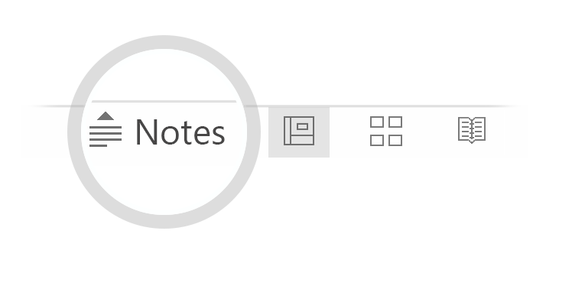

Here's your outline to get started
Key facts about your topic
Microsoft Azure is a cloud computing service created by Microsoft for building, testing, deploying, and managing applications and services through a global network of Microsoft-managed data centers. It provides software as a service, platform as a service and infrastructure as a service and supports many different programming languages, tools and frameworks, including both Microsoft-specific and third-party software and systems.
See more: Open the Notes below for more information.
Notes:
QuickStarter has created an outline to help you get started on your presentation. Some slides include information here in the notes to provide additional topics for you to research.

Slide 2
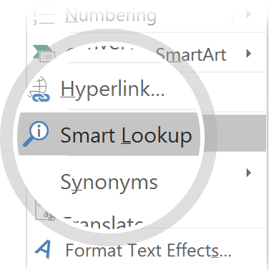
Related topics to research
Cloud computing
Azure PaaS
Microsoft
Infrastructure as a service
Satya Nadella
Oracle Cloud
Ray Ozzie
Azure AD Connect
IBM cloud computing
Rackspace Cloud
Use Smart Lookup to learn more
1
Highlight one of the related topics
Right-click on the topic
Choose "Smart Lookup"
2
3

Slide 3

Microsoft Azure
for Developers

Slide 4

Contents
IaaS vs PaaS for developers
Not covered Topics
Focused Topics
Services
Resources

Slide 5
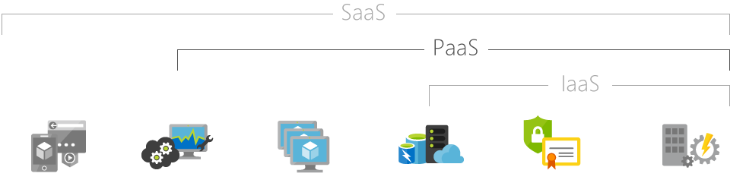
IaaS vs PaaS for developers
Notes:
Consider talking about:
Compute
Mobile services
Storage services
Data management
Messaging
Media services
CDN
Developer
Management
Machine learning

Slide 6

IaaS vs PaaS for developers
IaaS
Lift-and-Shift
Freedom to control
Not managed
Pay for full VM
PaaS
Application Environment
Controlled by Azure
Managed by Azure
Pay per use
Notes:
Consider talking about:
Compute
Mobile services
Storage services
Data management
Messaging
Media services
CDN
Developer
Management
Machine learning

Slide 7
Not covered topics
IaaS
Spark/BigData
AI/ML*Analytics*
Cloud Services
Networking
AAD
Provisioning*
Advanced Security
Governance
Media Services
IoT
Notes:
AAD = Azure Active Director

Slide 8
Focused Topics
PaaS/BUSaaS/CaaS/DBaaS/DevOps/IaC/DevTools

Slide 9
Platform as a Service
App Services
Web App
Web App for Containers*
Api App
Logic App
Mobile App
Function App
Function App for Containers*
App Insights
Notification Hub
Azure KeyVault
Api Management
Static Files
CDN
Service Fabric Mesh*
Azure Kubernetes Services*

Slide 10
BUS as a Service
SignalR Service
Service Bus
Event Hubs
Event Grid
Queue Storage

Slide 11
Container as a Service
Web App for Containers*
Function App for Containers*
Azure Container Registry
Azure Container Instances
Azure Container Services
Azure Kubernetes Services*
Service Fabric
Service Fabric Mesh*

Slide 12
Database as a Service
CosmosDB
MySql
PostgresSql
MariaDB
Redis Cache
Azure Table Storage
Azure Sql Database
Azure Manage Sql Server

Slide 13
DevOps
Azure DevOps Service
Azure DevOps Server
Azure Pipelines
Azure Repositories
Azure Boards
Azure Artifacts
Azure Test Plans

Slide 14
Infrastructure as Code
BuildScript as Code - YAML
ARM Templates
Helm/Terrafrom

Slide 15
DevTools
Azure Storage Explorer
Azure ServiceBus Explorer
Azure ARM-Tools
VSCode
VS 2017
Log Analytics
Azure Data Explorer
App Insights

Slide 16
Other important Services
Cognitive Services
Bot Services
Azure Search
Azure Storage Blobs
Azure Storage Files
Azure Stream Analytics
AAD / Managed Identity
IoT Edge

Slide 17

Resources
https://azure.microsoft.com/en-us/overview/what-is-paas/
https://azure.microsoft.com/en-us/services/

